Slide 1

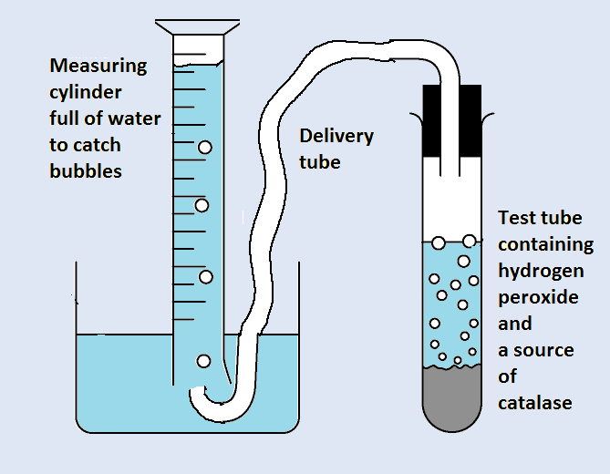
IB Biology Enzyme Reactions
Student Review Sheet
Introduction
In IB internal assessment (IA) there are some important components required in each experiment design
Complete the following pages for the explanations
Of each experiment.
By doing this you will have identified some of
the most important parts in a plan.

Slide 2

Method A: Measuring the Rate of the Reaction as the experiment progresses
Method
Hypothesis?
Dependent Variable
Sketch Graph
Experiment diagram
How many repeats?
Independent Variable
Variables controlled (kept constant)
Safety
Range of the independent variable
Actual Values
Tips for Perfection?

Slide 3
Method B: Measuring the Rate with different concentrations of substrate (Hydrogen Peroxide)
Method
Hypothesis?
Dependent Variable
Sketch Graph
Experiment diagram
How many repeats?
Independent Variable
Variables controlled (kept constant)
Safety
Range of the independent variable
Actual Values
Tips for Perfection?

Slide 4
Method C: Measuring the Rate with different pH of solution
Method
Hypothesis?
Dependent Variable
Sketch Graph
Experiment diagram
How many repeats?
Independent Variable
Variables controlled (kept constant)
Safety
Range of the independent variable
Actual Values
Tips for Perfection?

Slide 5
Method D: Measuring the Rate at different temperatures
Method
Hypothesis?
Dependent Variable
Sketch Graph
Experiment diagram
How many repeats?
Independent Variable
Variables controlled (kept constant)
Safety
Range of the independent variable
Actual Values
Tips for Perfection?

